Slide 1
Air Source Heat Pump Introduction
Will Rossiter

Slide 2
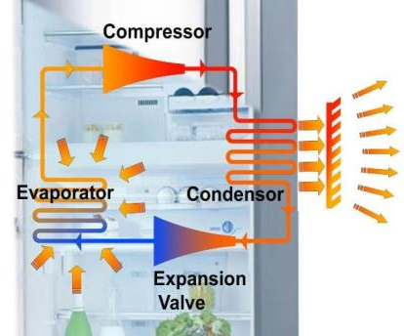
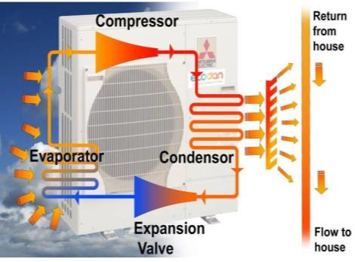
How Does a Heat Pump Work?
Energy Source = Food
Output heat = Back of fridge
Energy Source = Heat in air
Output heat = To return water from house via heat exchanger

Slide 3
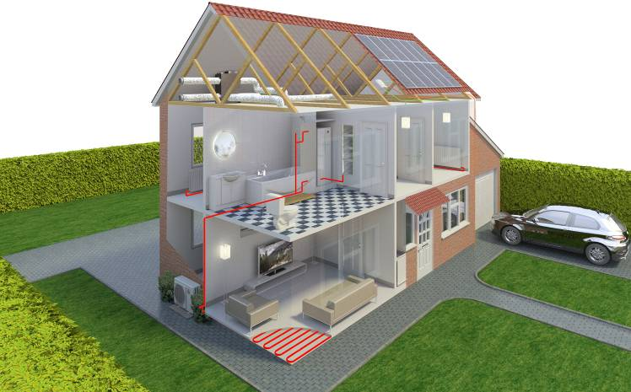
Home Integration & Application
Provides all Domestic Hot Water and Space Heating
DHW cylinder supplying shower etc.
Heat Pump positioned
externally
Supplies space heating via
underfloor or radiators

Slide 4
Estimated ASHP Run cost comparison
Estimated % increase in running cost p/kwh versus Gas
Fuel unit cost : https://energysavingtrust.org.uk/about-us/our-calculations

Slide 5
Thank You
T: 07384 877119
E: william.rossiter@meuk.mee.com
W: ecodan.co.uk
Will Rossiter
Notes:
RT CLOSE.

