Slide 1
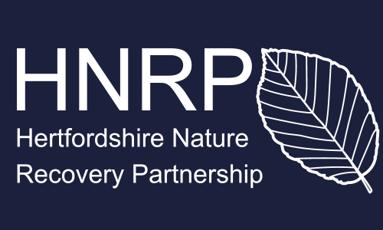
Local Nature Recovery in Hertfordshire

Slide 2
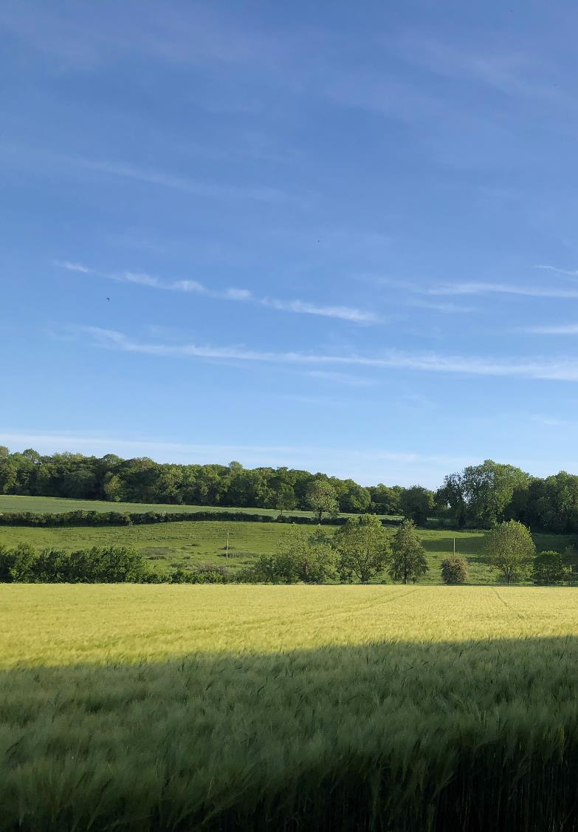
What is a Local Nature Recovery Strategy?
Comprehensive Nature Recovery Strategy – not just biodiversity.
A collaborative strategy for Hertfordshire, by Hertfordshire
It is required by law (Environment Act 2021)
It will deliver benefits for wildlife, nature and residents
Draft expected by March 2025
Notes:
Required by Environment Act 2021
Funded by Central Government
Aim is to show how and where to recover nature and improve the wider environment across England.
Every county will have one.
Nature recovery not Biodiversity Recovery. This strategy is wide in scope including not just biodiversity but also eco system services more generally – flood mitigation, renewable energy and carbon sequestration opportunities as well as health and well-being co-benefits such as improving access to green space.
Will be delivered in the next 2 years.

Slide 3
What will the LNRS look like?
A map-based tool(s) that is:
Publicly Accessible
Free to use
Functional for a variety of users and purpose
Notes:
So what do we get out of the Local Nature Recovery Strategy Project?
Geographically linked priorities so you can see within a given area:
what projects are taking place,
what priorities have been set and
how you can get involved
what funding is available.
We will have several outputs. The LNRS is not just a MAP or a list of priorities.
The minimum output is a published (unchanging) map identifying all appropriate habitats and opportunities that is publicly accessible. This will then be reviewed and republished every 3-10 years (republication date to be decided by secretary of state).
We can do better than that. We will have a multi-functional online map tool that is live, updated on a much more regular basis with ecology surveys completed in the county BNG sites registered and other data. It will provide planning and sustainability teams with highly useful information about the co-benefits of any given site. It will also be useful to the general public and businesses looking for ways to help nature recover.

Slide 4
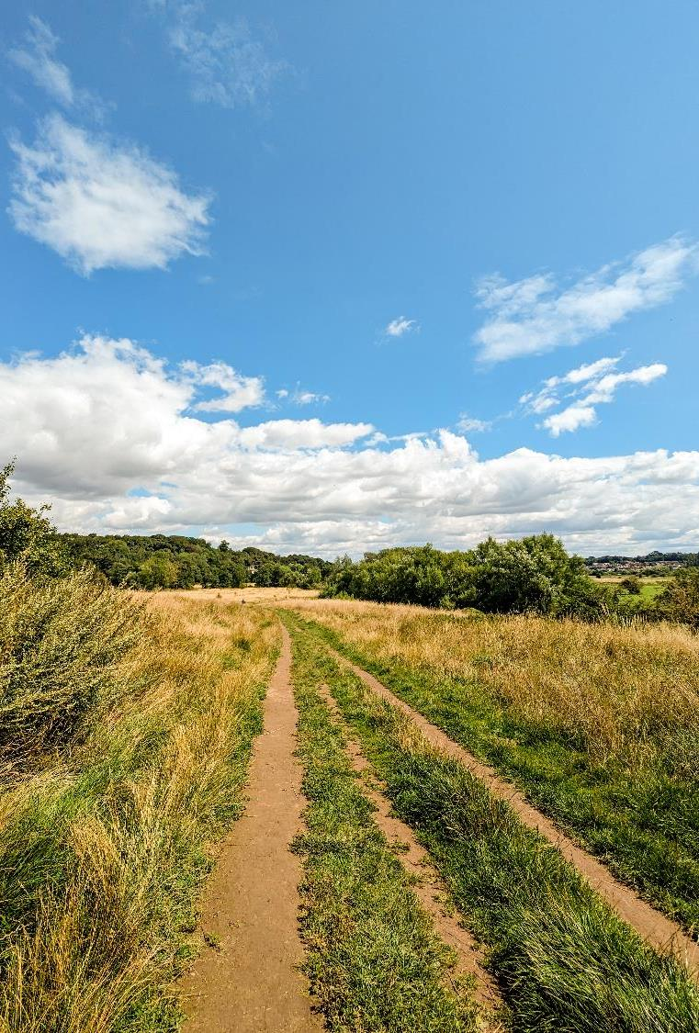
What Will the LNRS do?
The LNRS will answer three questions about nature recovery:
What can we do?
How can we do it?
Where can we do it?
Notes:
Mapping will identify
1.the most valuable existing areas for nature,
2.areas of greatest potential for creating valuable habitats through creating or improving habitats
3.where creation or improvement of habitat could deliver wider environmental benefits (including air and water quality, flood mitigation, carbon sequestration and renewable siting).
Through mapping these areas we will also identify areas valuable habitat could be increased and where there is potential for joining up isolated sites.
We also hope to map where habitats can deliver health and well-being benefits too for instance improving access to green space.
Will integrate with BNG work.
Sites of ‘strategic significance’ will be identified. Developers will be incentivised to deliver BNG in these sites by receiving an uplift for BNG in these zones.
To complete this mapping, data will be used from a wide range of stakeholders to ensure we have the accurate and comprehensive view of county.

Slide 5
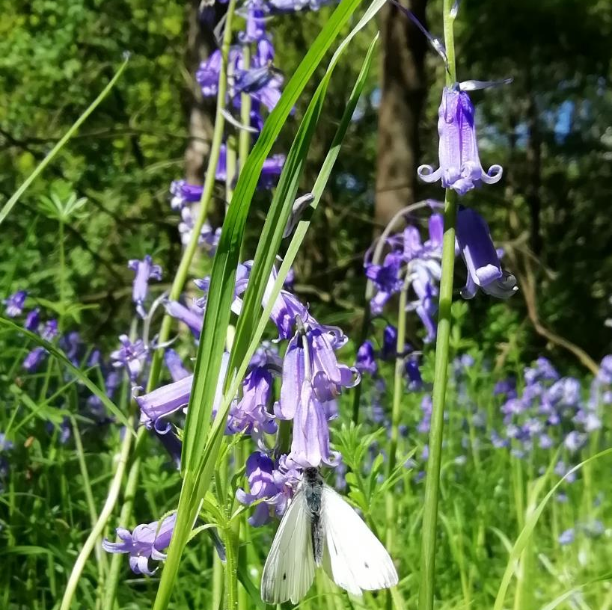
What & How?
Strategic priorities for habitats and species
Measures – actions to delivery priorities
Projects (proposed and ongoing)
Notes:
The priorities work will look at identifying strategic priorities for the county.
These will include overarching long term priorities identifying the species and habitats of most importance to the county and how to protect and enhance them
as well as
short terms goals with clear actions on how to deliver these priorities eg increasing improving the quality of water habitat in Dacorum to through removing weeds and concrete channelling.
Actions will also be linked to grant and funding opportunities where available providing a one stop shop for information about delivering nature recovery projects in the county.
Priorities will be set on a county wide scale focusing delivering a joined up approach on nature recovery for all stakeholders in the county allowing the pooling of resources and more effective, joined up project work. Making the sum of our output greater.
Planning applications will have to have regard for the priorities in the LNRS, providing strategic sustainability and nature recovery guidance for the county.

Slide 6
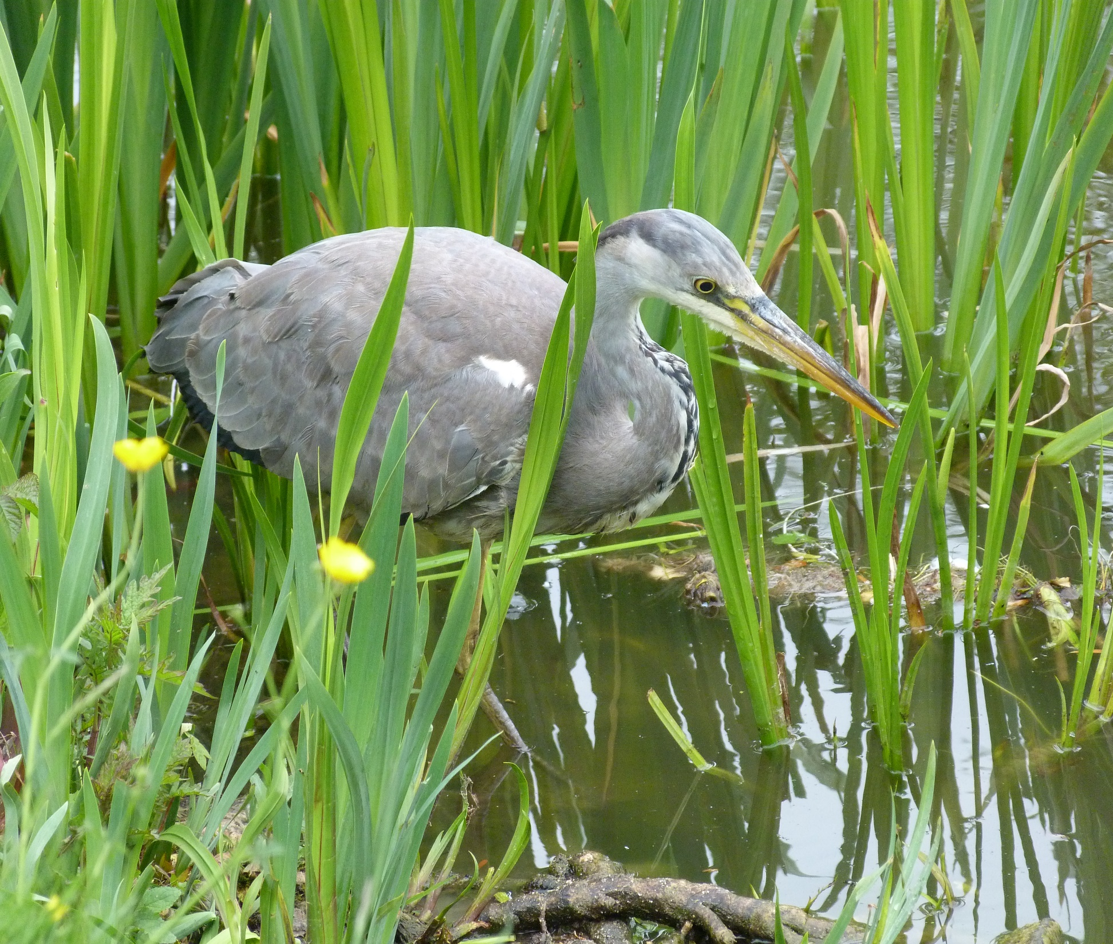
Where?
1. Areas with high nature value
2. Areas of potential for creating valuable habitats
3. Areas where creation or improvement of habitat could deliver wider environmental benefits
Notes:
Mapping will identify
1.the most valuable existing areas for nature,
2.areas of greatest potential for creating valuable habitats through creating or improving habitats
3.where creation or improvement of habitat could deliver wider environmental benefits (including air and water quality, flood mitigation, carbon sequestration and renewable siting).
Through mapping these areas we will also identify areas valuable habitat could be increased and where there is potential for joining up isolated sites.
We also hope to map where habitats can deliver health and well-being benefits too for instance improving access to green space.
Will integrate with BNG work.
Sites of ‘strategic significance’ will be identified. Developers will be incentivised to deliver BNG in these sites by receiving an uplift for BNG in these zones.
To complete this mapping, data will be used from a wide range of stakeholders to ensure we have the accurate and comprehensive view of county.

Slide 7
Hertfordshire Nature Recovery Partnership
Hertfordshire Nature Recovery Partnership
Local Stakeholders
Supporting Authorities
Central gov. Arm’s length Bodies
Responsible Authority
A Hertfordshire Nature Recovery Partnership has been established to deliver the LNRS.
The Partnership includes representatives from a wide range of backgrounds.
Hertfordshire County Council, as the ‘Responsible Authority’ for Hertfordshire, will provide a Project Manager and chair the Partnership.
The Partnership will work with wider stakeholders across Hertfordshire. You don’t need to be in the partnership to get involved in the LNRS.
Notes:
The Responsible Authority will manage the budget for the partnership, report back to Defra and chair the Partnership
The other Local Planning Authorities (and Natural England) are Supporting Authorities and will need to ‘sign off’ on strategy before publication.
Steering Group:
Hertfordshire County Council
The Environment Agency
Natural England
Forestry Commission
The Herts & Middlesex Wildlife Trust
Hertfordshire Environmental Records Centre
Rural Land Management Advisory Group
Hertfordshire Sustainability Officer Group
Hertfordshire Planning Group
Hertfordshire Infrastructure & Development Board
Hertfordshire Association of Parish and Town Councils
Lea and Colne River Catchment Partnerships
Public Health (Hertfordshire County Council)
The Board:
Hertfordshire County Council
The Herts & Middlesex Wildlife Trust
Hertfordshire Climate Change Sustainability Partnership
Hertfordshire Growth Board
Hertfordshire Infrastructure & Planning Partnership

Slide 8
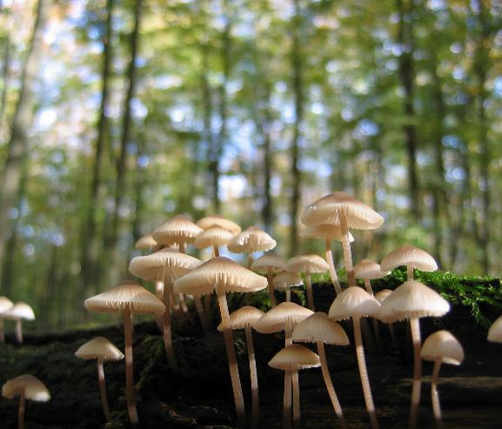
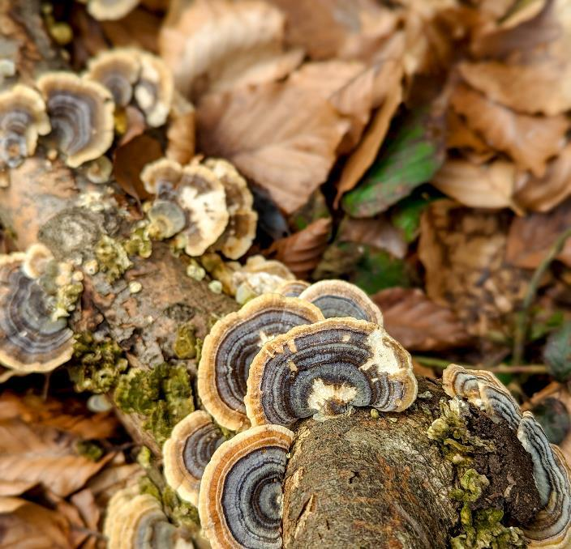
Engaging with Communities
We are reaching out to communities because we want to:
Gather local knowledge of Hertfordshire’s species and habitats (as well as existing and upcoming nature recovery projects) from the wider community groups in Hertfordshire.
Inform communities about the functions and requirements of the completed LNRS and opportunities it offers. Generate interested in and support for the LNRS and Nature recovery more generally.
Understand communities’ needs for the completed LNRS to ensure that it is accessible, useful and intuitive, tailored to the users' differing needs.
2

Slide 9
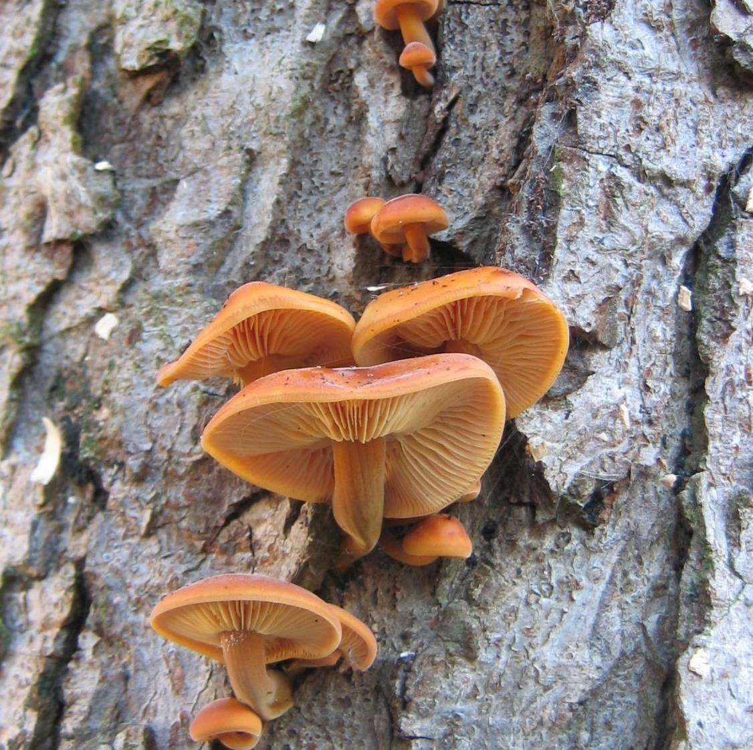
What we want to know?
We are gathering information across four key topic areas:
The nature recovery goals your community wants to achieve.
To identify key species and areas in Hertfordshire.
Ongoing and proposed nature recovery projects and funding.
What your community wants from the LNRS tool.

Slide 10
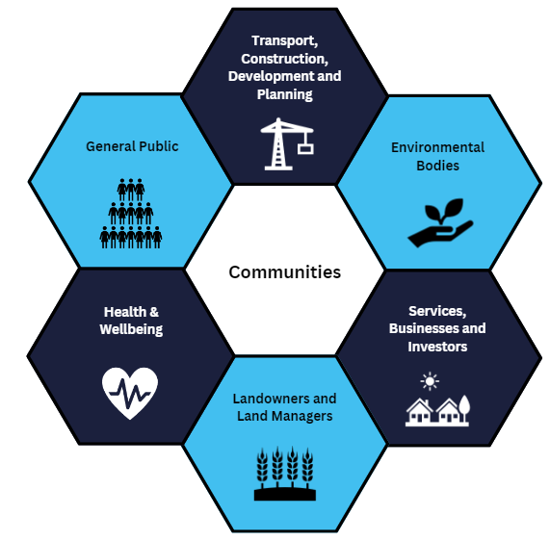
Communities
We have broadly categorised Hertfordshire residents into 6 communities. You may fit into more than one of these groups.
3

Slide 11
Delivering Engagement
There will be 8 key engagement stages throughout the creation of the LNRS:
9

Slide 12
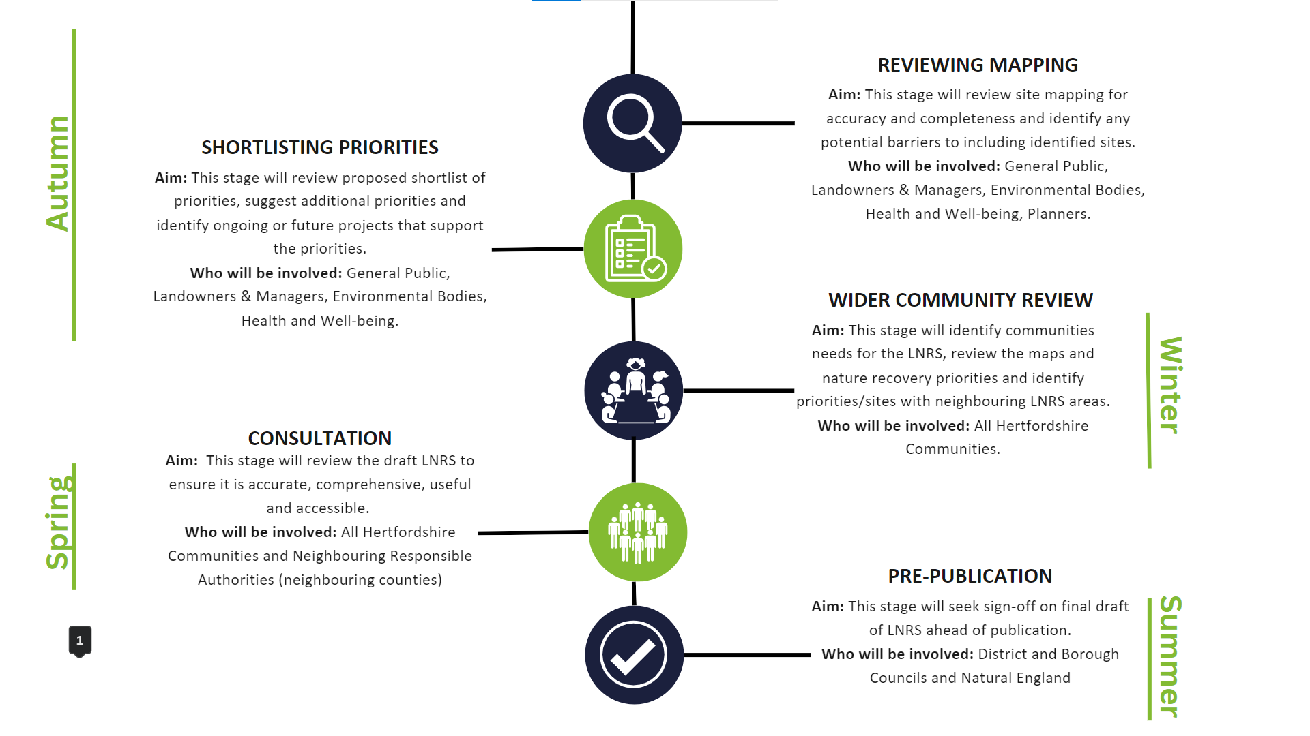
10

Slide 13
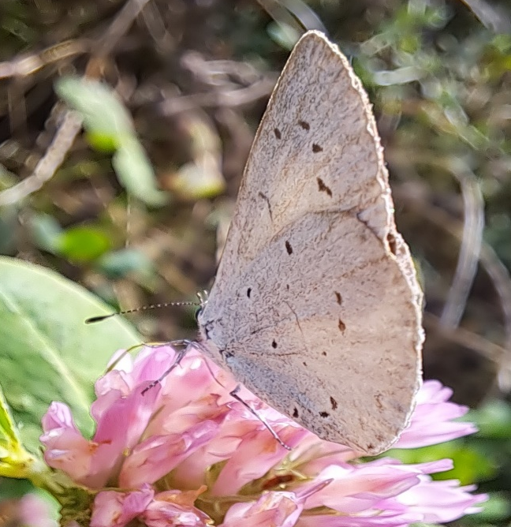
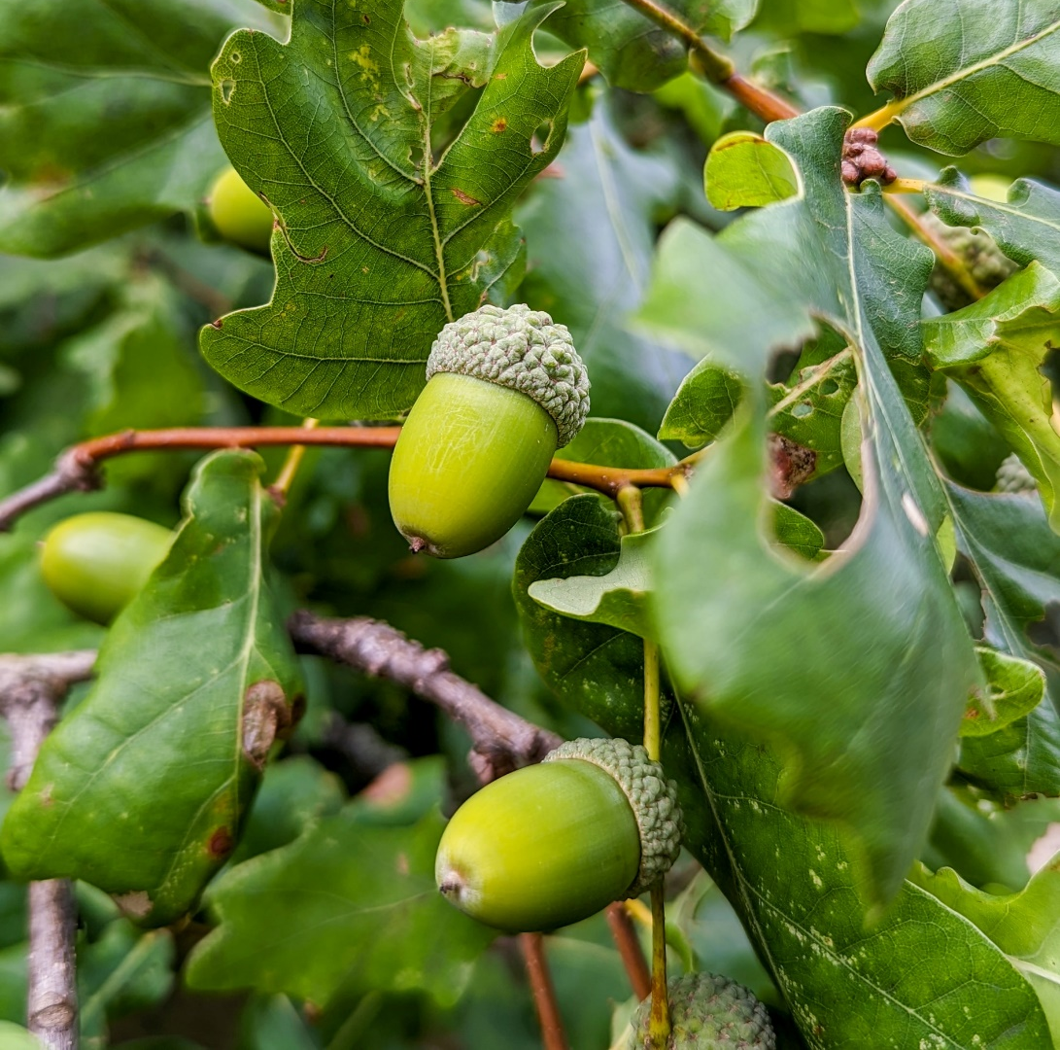
What happens next?
Event for land owners or land managers in Hertfordshire on 30th May
We’ll be at the County Show on 26th May
Online surveys to identify sites and nature priorities Late May
In person workshop events in June and July

Slide 14
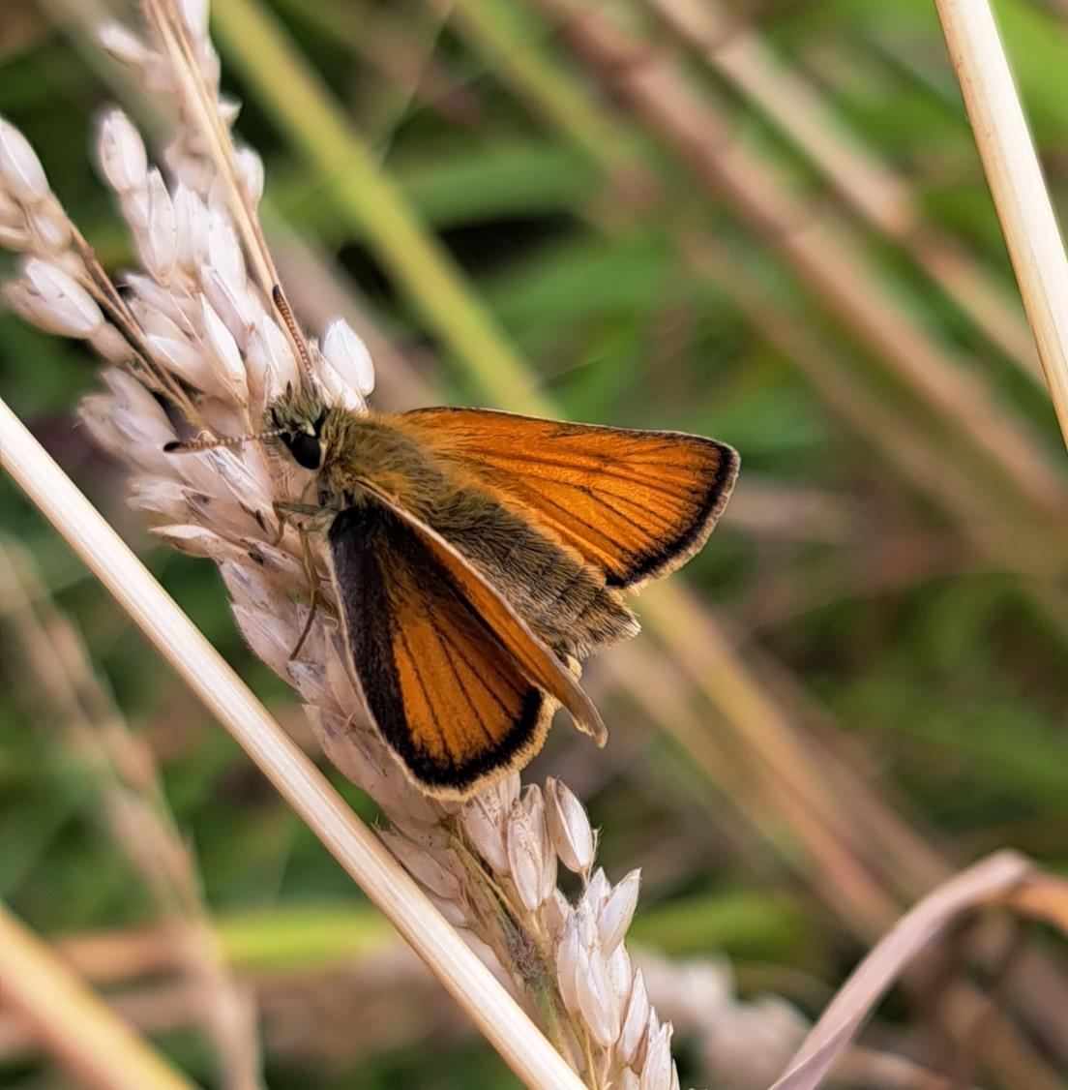
Get in touch
Find out more and subscribe to updates at:
Hertfordshire Nature Recovery Partnership | Hertfordshire County Council
Contact us:
LocalNatureRecovery@hertfordshire.gov.uk
11

